Slide 1

KOSS Task
By Krish

Slide 2

What is git?
git is a free and open-source distributed version control system designed to handle everything from small to very large projects with speed and efficiency.
It is a software for tracking changes in any set of files, usually used for coordinating work among programmers collaboratively developing source code during software development.
Its goals include speed, data integrity, and support for distributed, non-linear workflows.

Slide 3
Some New Git Commands

Slide 4

git switch
Used to switch to another branch.
An alternative to git checkout to avoid confusion (as checkout can work on both file and branch level).
To go back to the previous branch:

Slide 5
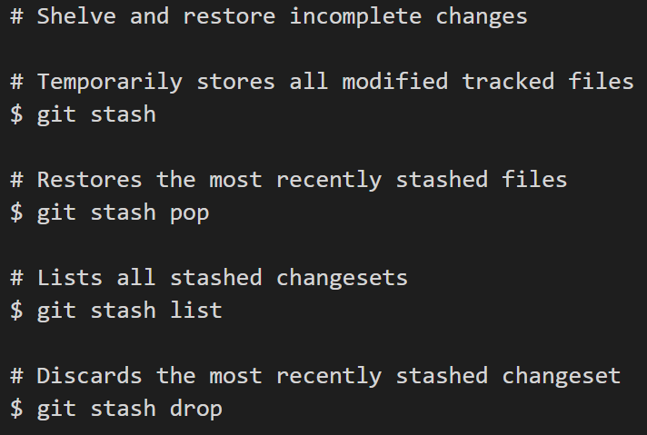
git stash
Used to stash local changes without git commit or git push.
Helps to avoid dirty commits by saving a draft of what you're currently working on.

Slide 6
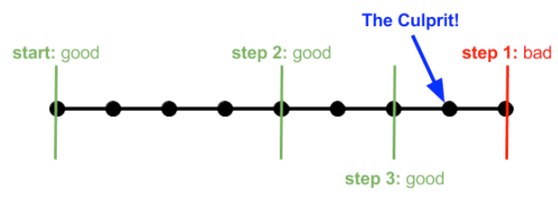
git bisect
The git bisect command is used to discover the commit that has introduced a bug in the code.
This command uses binary search algorithm.
It helps track down the commit where the code works and the commit where it does not, hence, tracking down the commit that introduced the bug into the code.

Slide 7
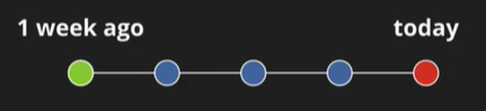
Example for git bisect
assuming the third commit is the bad commit,
Git selects the commit in the middle of the history (third in this case). As this version is still bugged, we enter
$ git bisect bad
Now, git selects the commit between first and third, which is second. As this isn't bugged, we enter
$ git bisect good
As there isn't any version between second and third, the command prints out the description of the bad (third) commit.

Slide 8
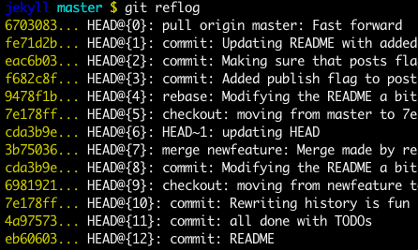
git reflog
It is similar to log but can also used for commands that don't show up in your commit history.
reflog is basically your safety net after running "scary" commands like git rebase.
You'll be able to see not only the commits you made, but each of the actions that led you there

Slide 9

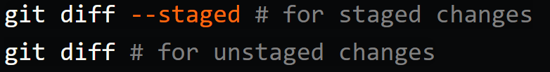
git diff
Used to see differences between:
Branches
staged (or unstaged) changes.

Slide 10
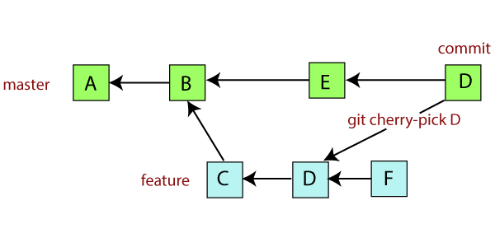
git cherry-pick
Used to pick changes from another branch and then apply to our branch.
eg. When in the feature branch, enter:
$ git cherry-pick D
The D commit (from master) is cherry picked into our feature branch.

Slide 11
git rebase
Has a reputation for being magical Git voodoo that beginners should stay away from.
It can be used as an alternative to git merge.
Reapplies commits on top of another base tip.
Can be used if you prefer a clean, linear history free of unnecessary merge commits.

Slide 12
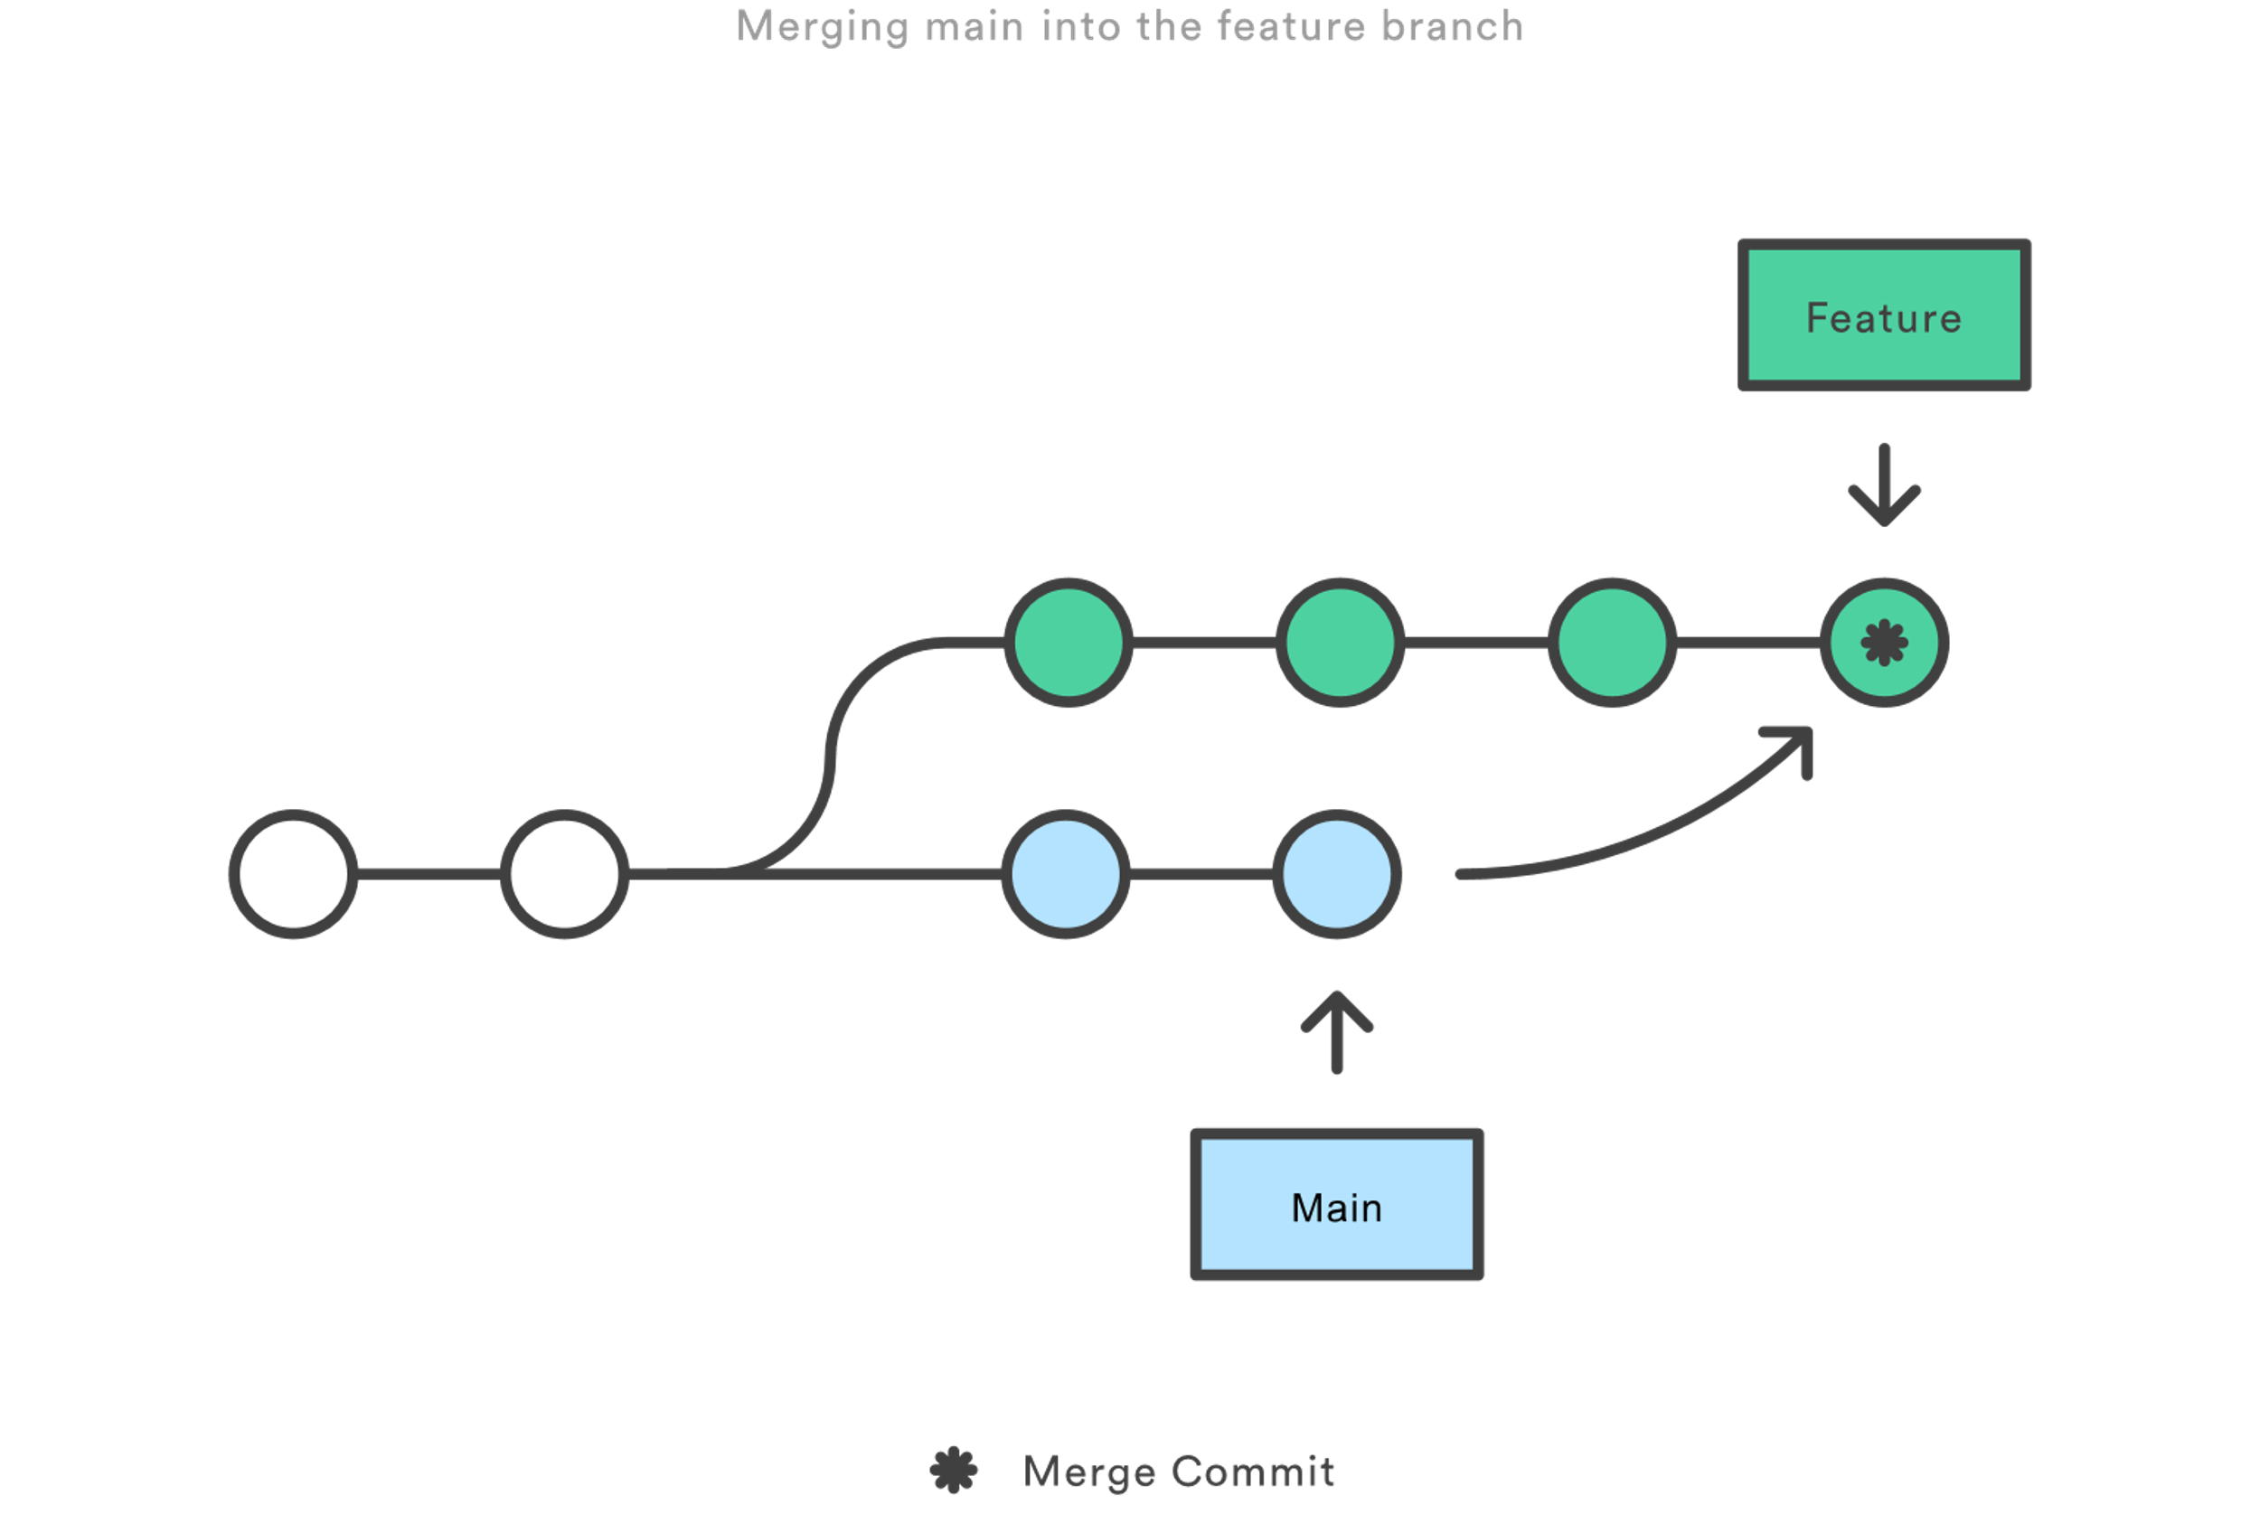
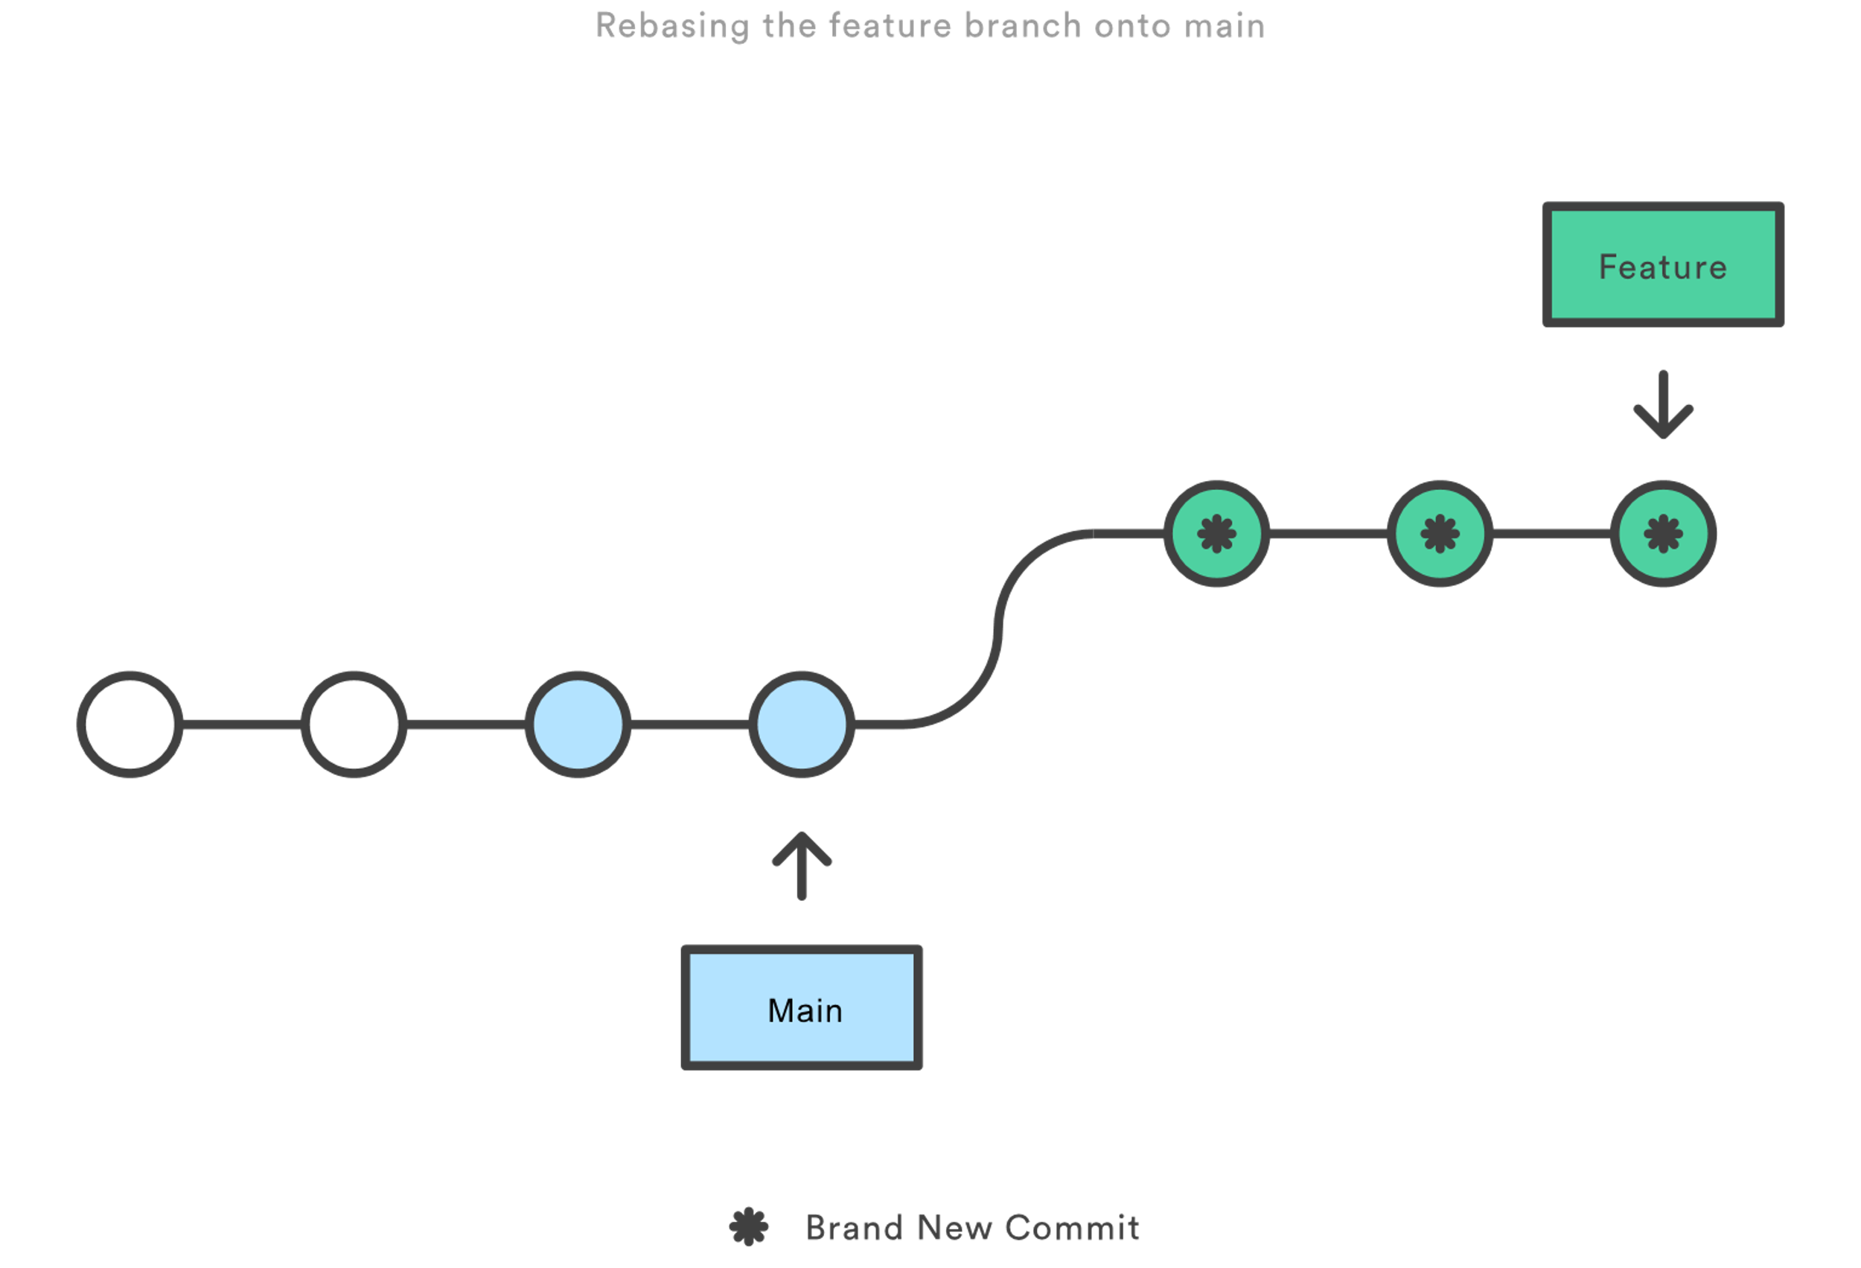
merge vs rebase
Generally, you should merge to main branch and rebase the feature branches.

Slide 13
Thank You!

